Slide 1



AI Workshop 4: Ethics of AI (Online) Saturday 8th March 2025
Omar Choudhry

Slide 2

Learning Objectives
By the end of this lesson, you will be more aware of the following ethical issues:
Job Displacement
Bias & Discrimination
Privacy & Trust
Black-box Nature
Over-Reliance & Autonomy
Accessibility
Responsibility
Environmental Impact
Hacking
Medical Diagnosis
Intellectual Property
Politics
Surveillance
Misinformation

Slide 3
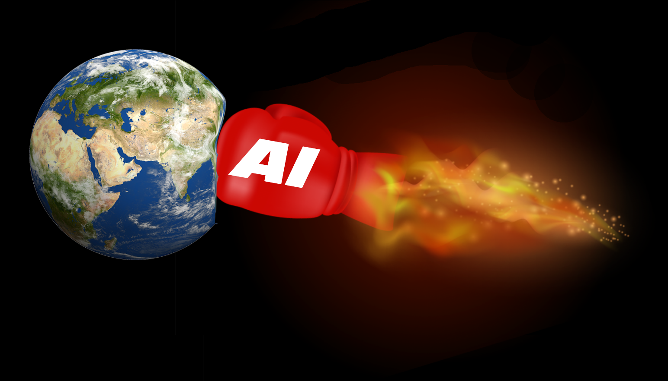
Ice Breaker

Slide 4
Ice Breaker (5 mins)
What’s one ethical dilemma you’ve heard about in tech recently?

Slide 5
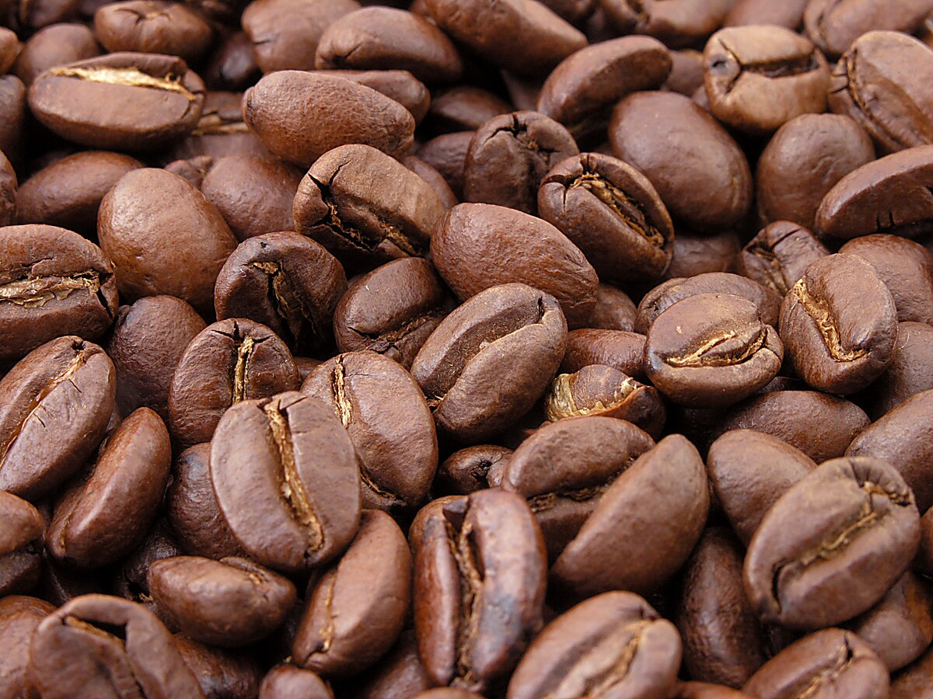


Job Displacement

Slide 6
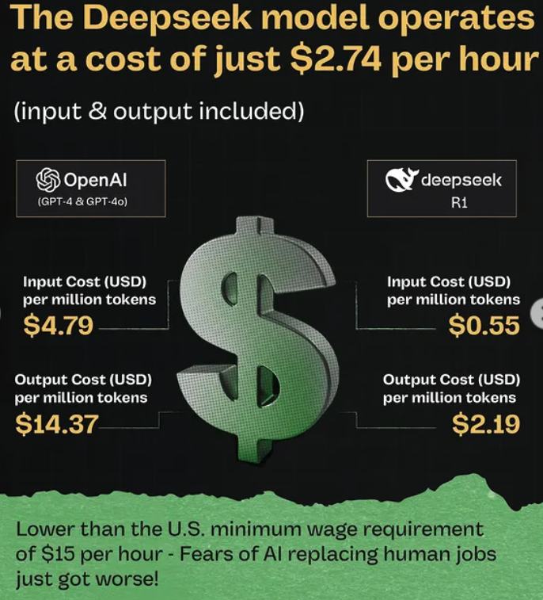
Job Displacement

Slide 7
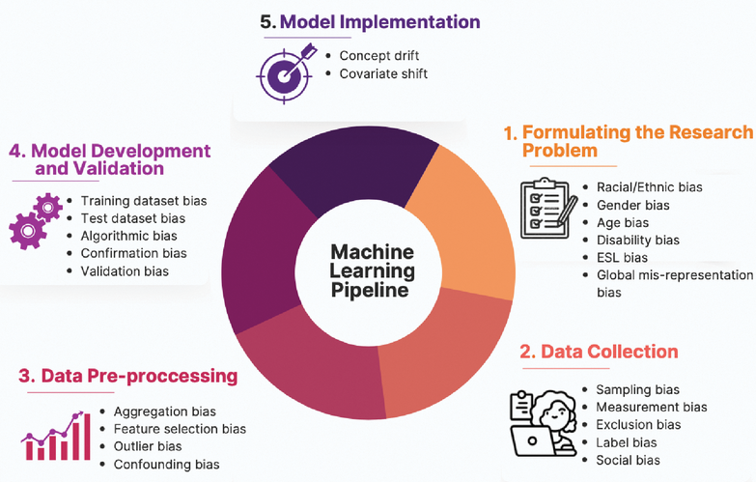
Bias & Discrimination

Slide 8
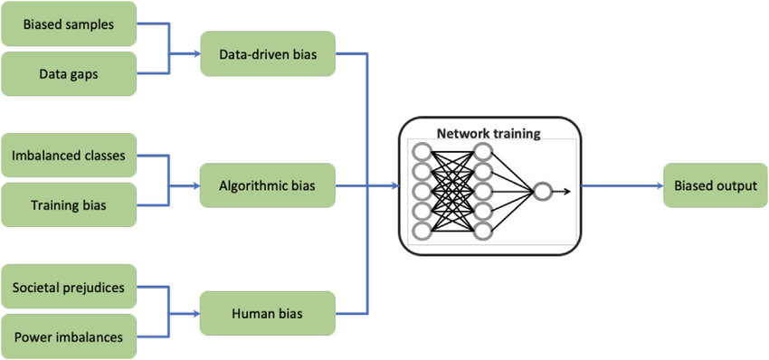
Bias & Discrimination

Slide 9
Bias & Discrimination (5 minutes)
“A company uses an AI tool to screen job candidates. Later it’s discovered that certain groups are consistently scored lower by the tool.”
Where might bias or unfairness have come from?
How could the organisation address or prevent it?
Who should be held accountable for the outcomes?

Slide 10
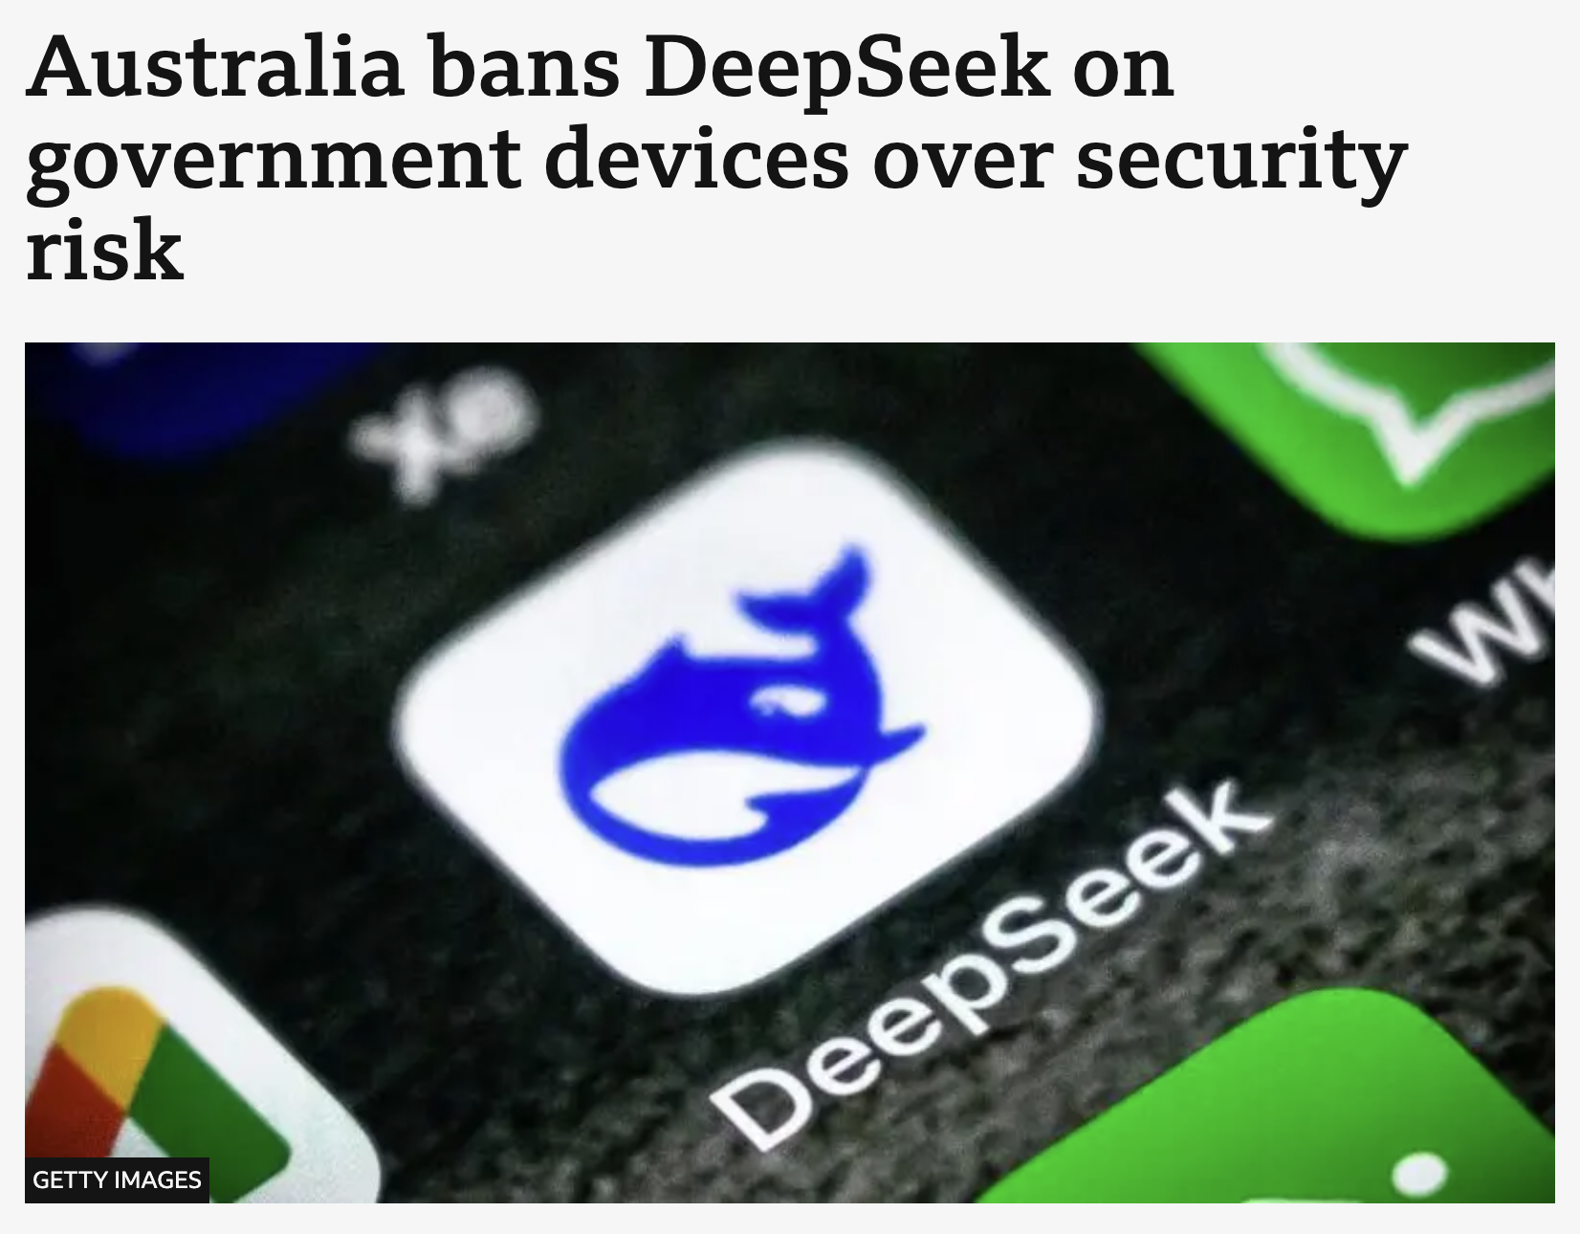
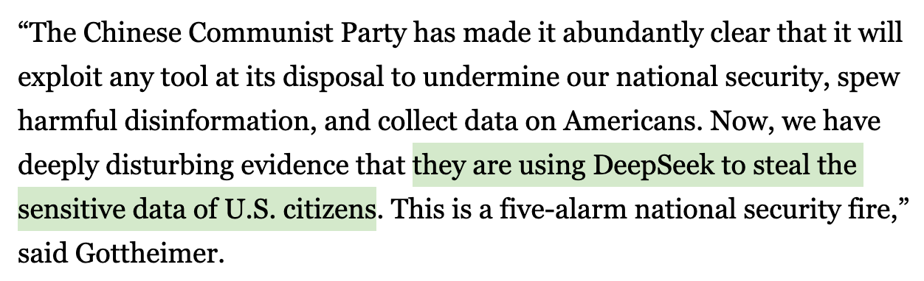
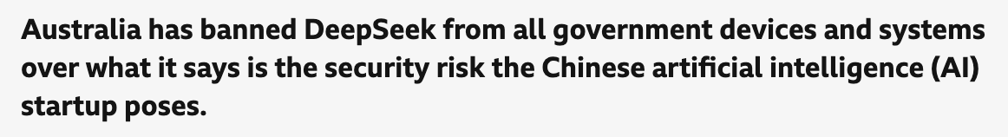
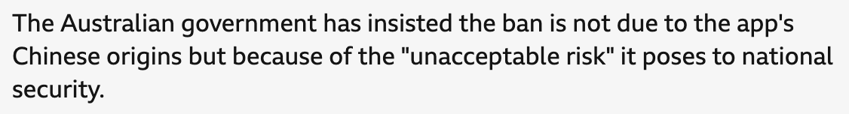
Privacy & Trust

Slide 11
Black-Box Nature (5 mins)
What’s the problem with models of a black-box nature?

Slide 12
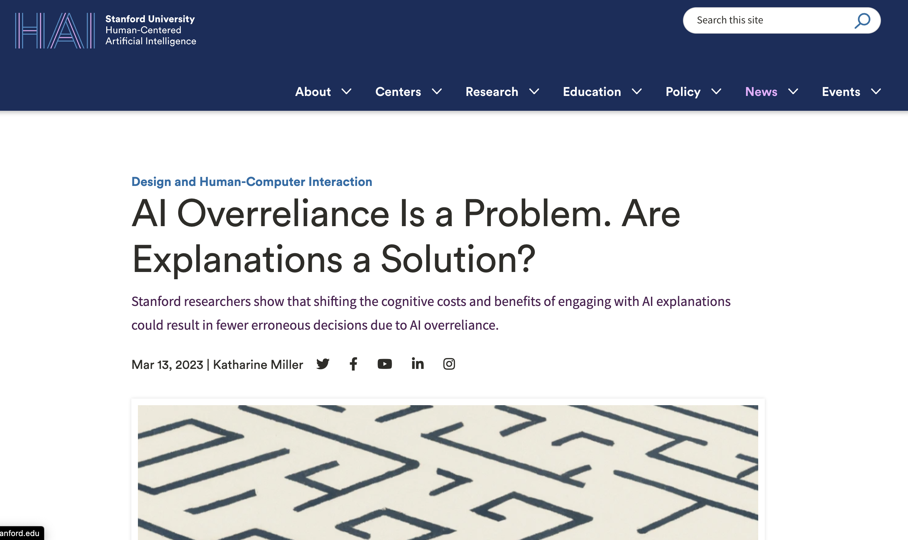
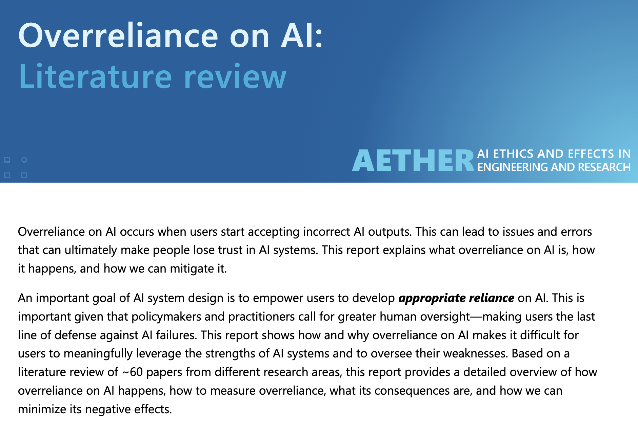

Over-Reliance

Slide 13
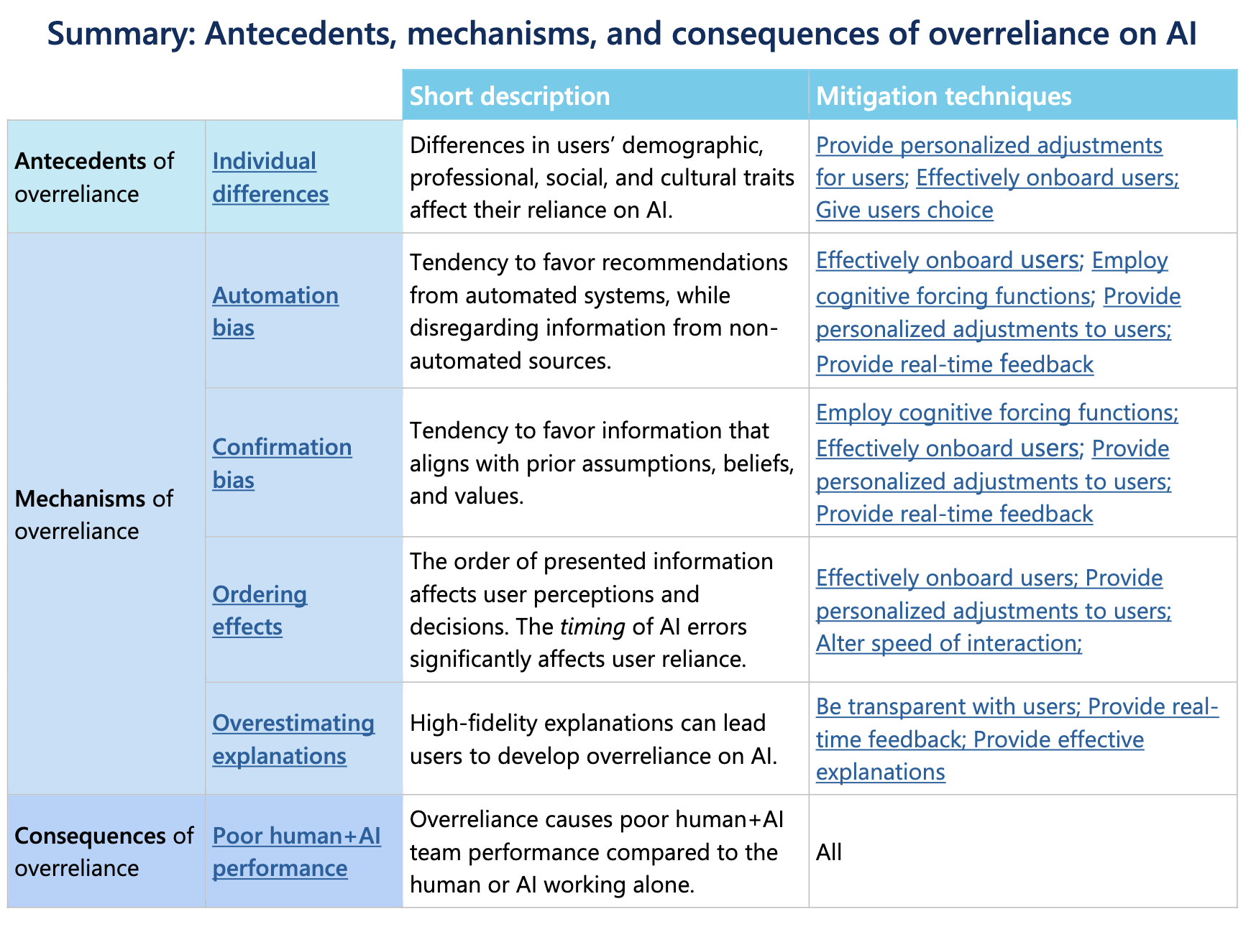
Over-Reliance & Autonomy

Slide 14
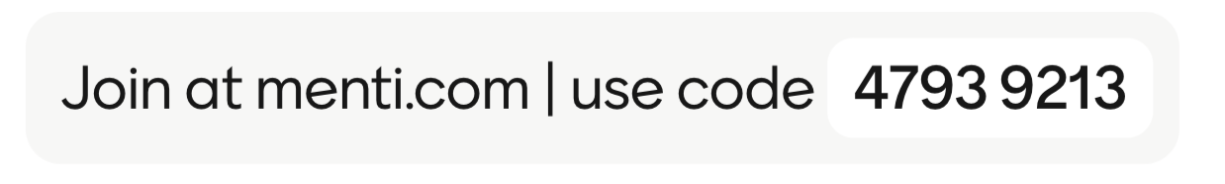
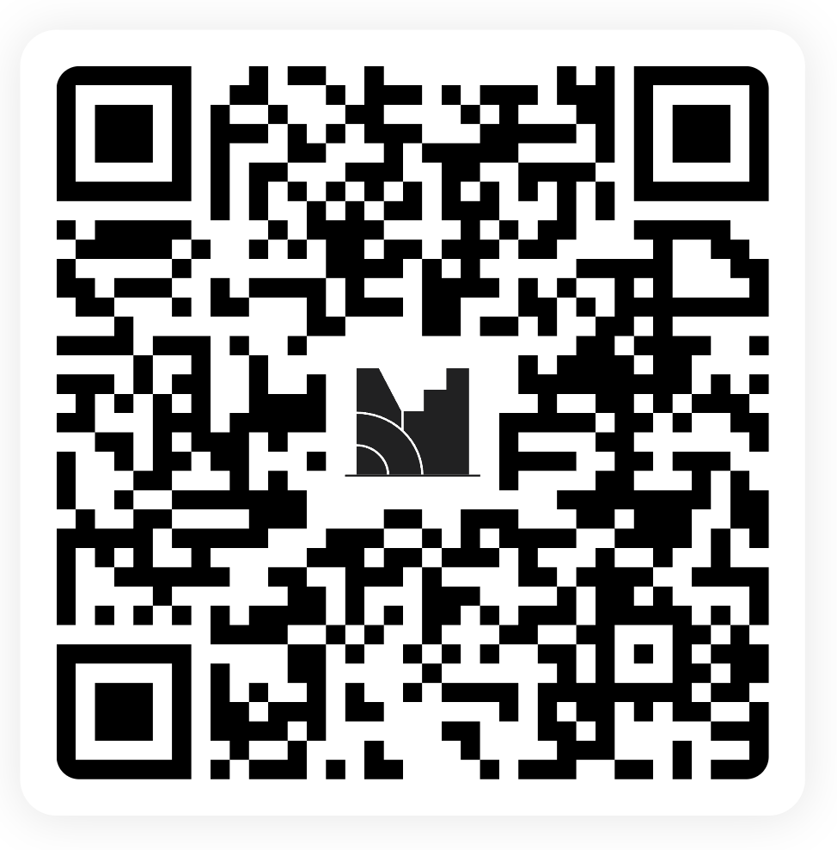
Your turn.
Notes:
https://www.mentimeter.com/app/presentation/al97ntsprjhg6hbq65jys9ky2x2bfcc5/edit?question=qott1z9qc1e8

Slide 15
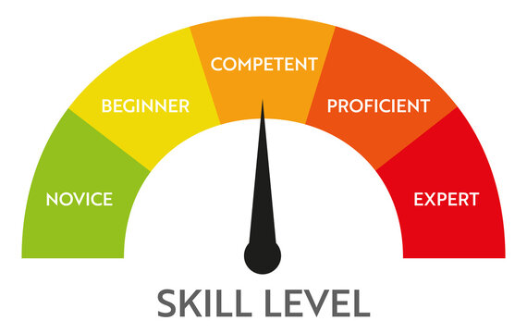
Accessibility

Slide 16
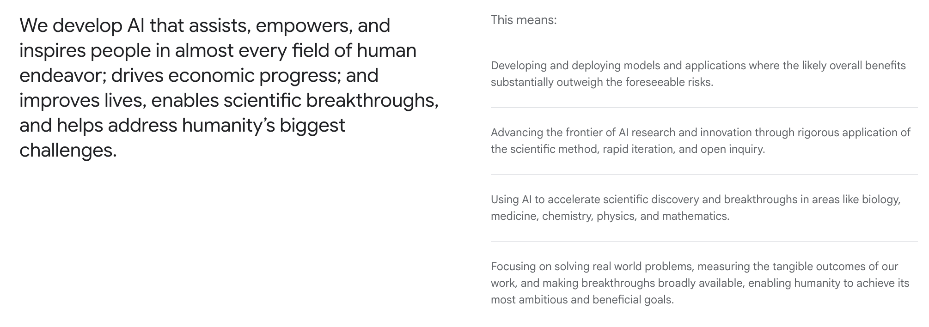
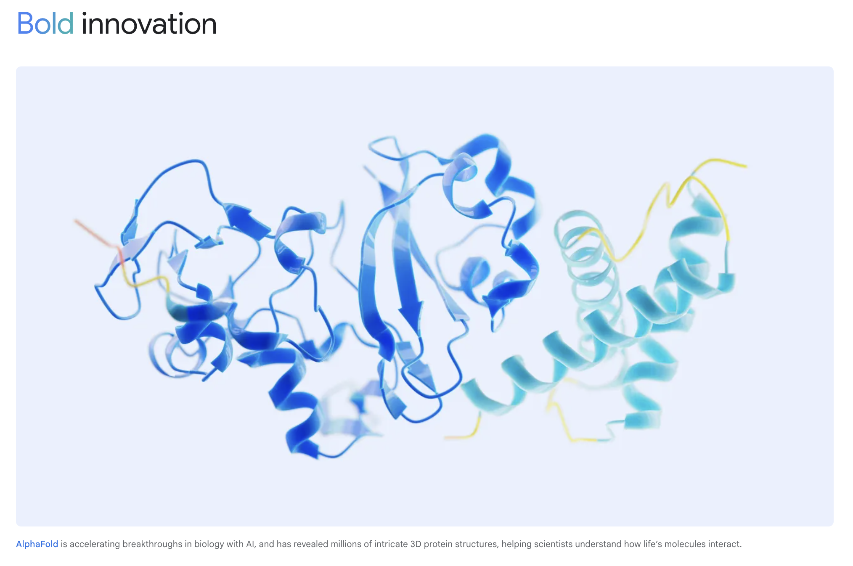
Responsibility

Slide 17
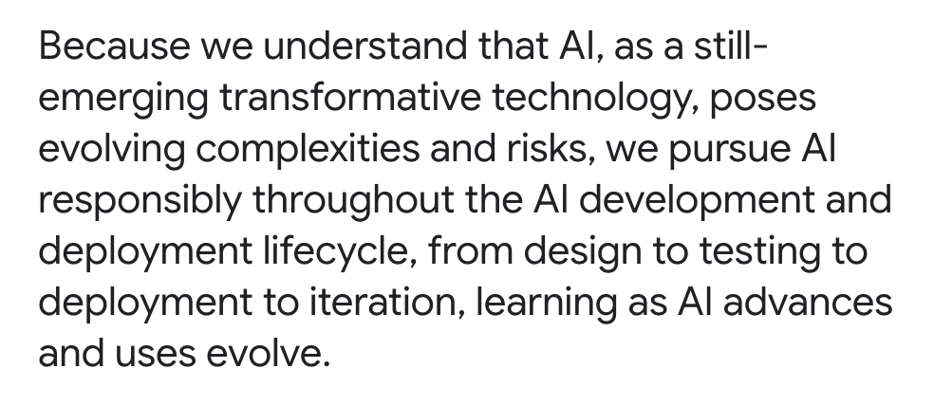
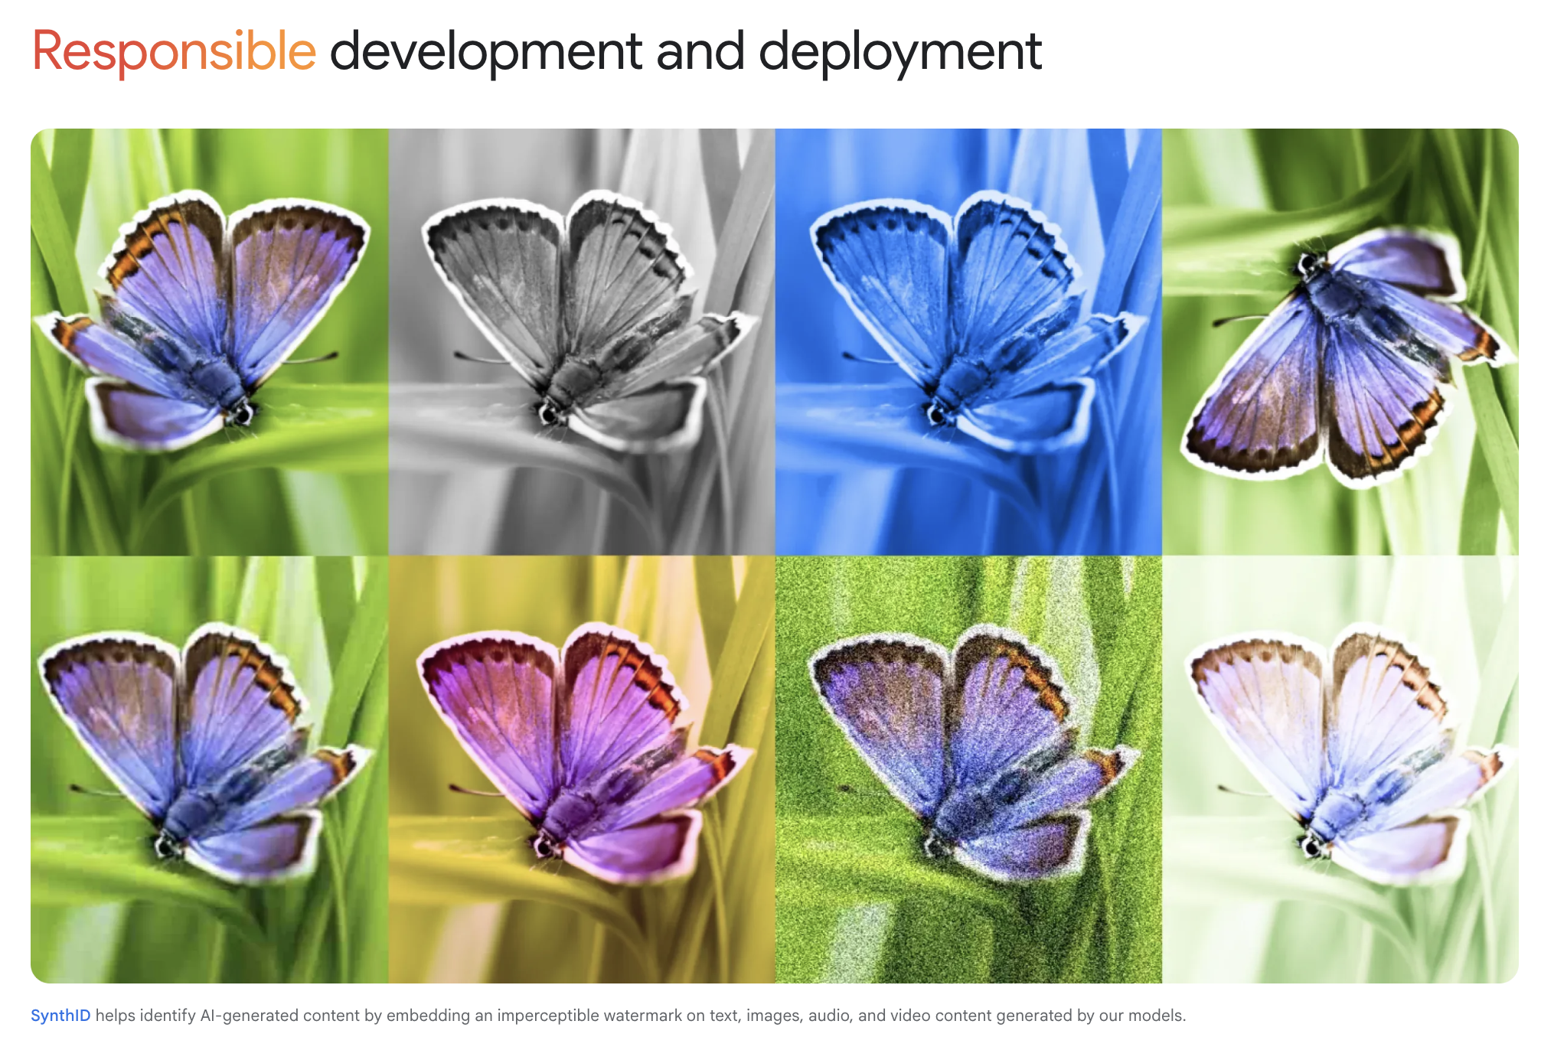
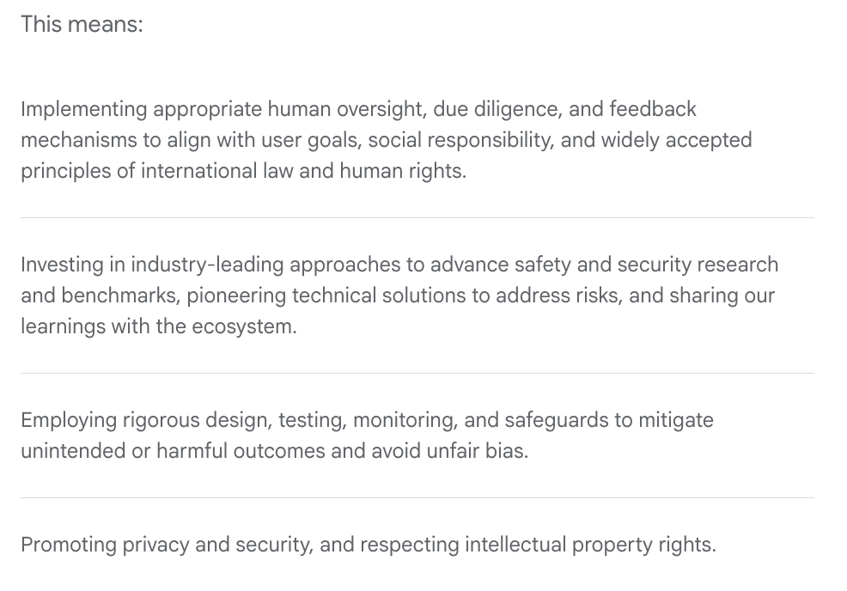
Responsibility

Slide 18
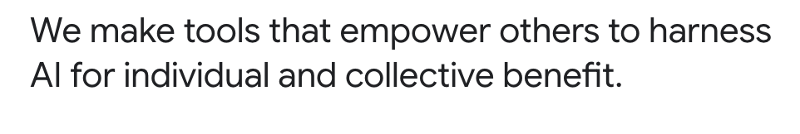
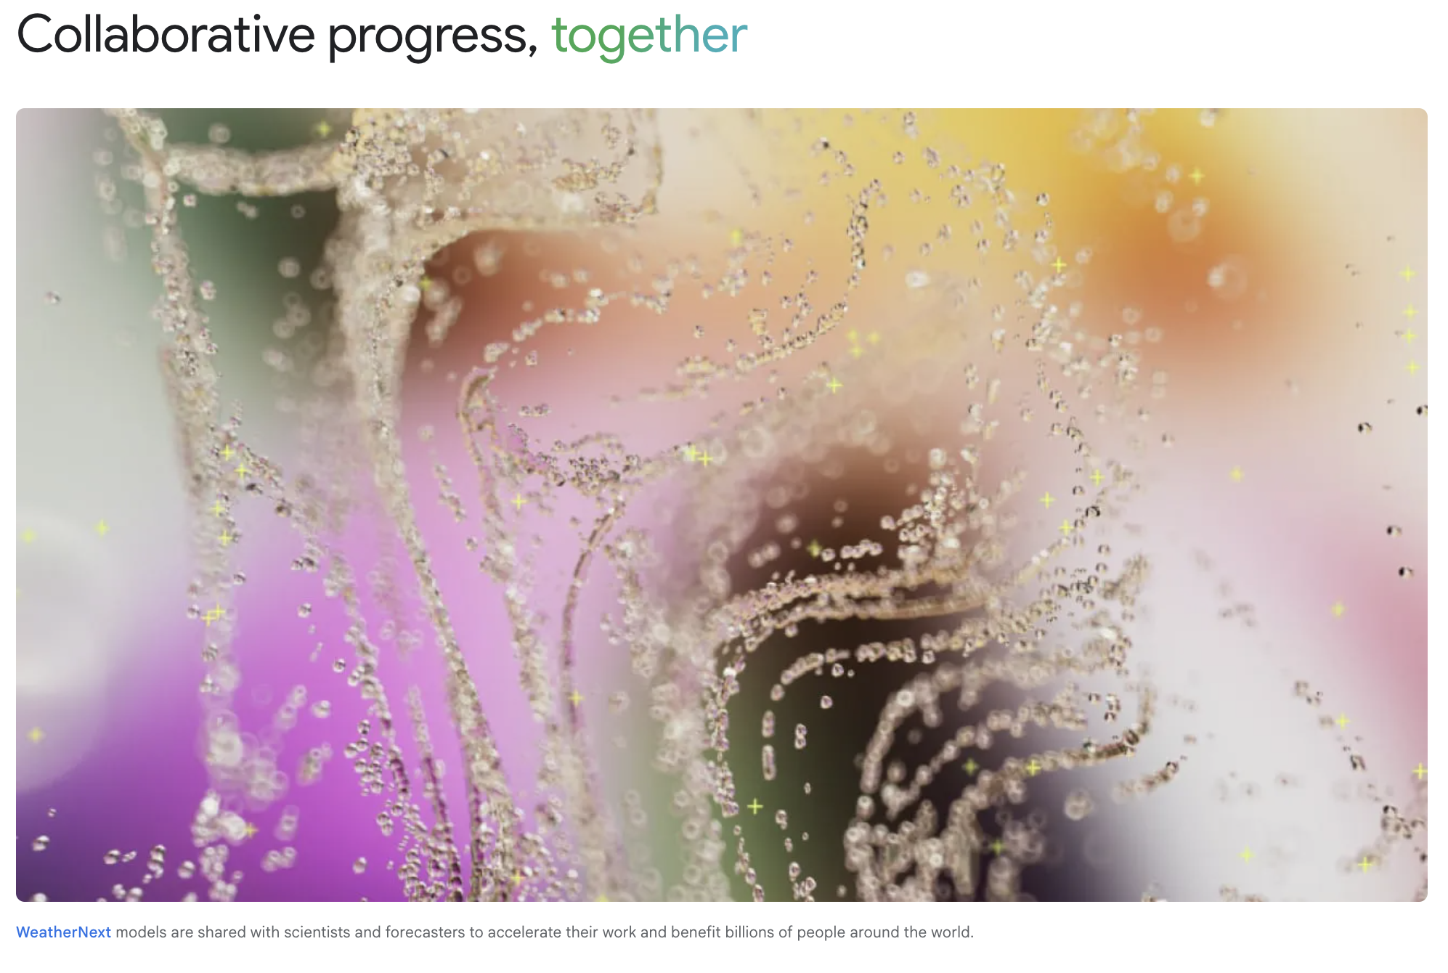
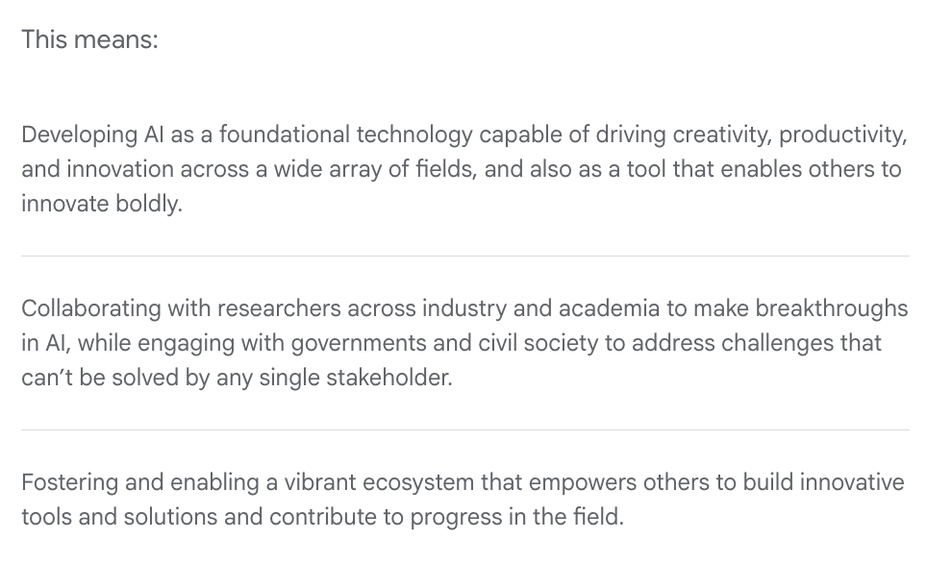
Responsibility

Slide 19
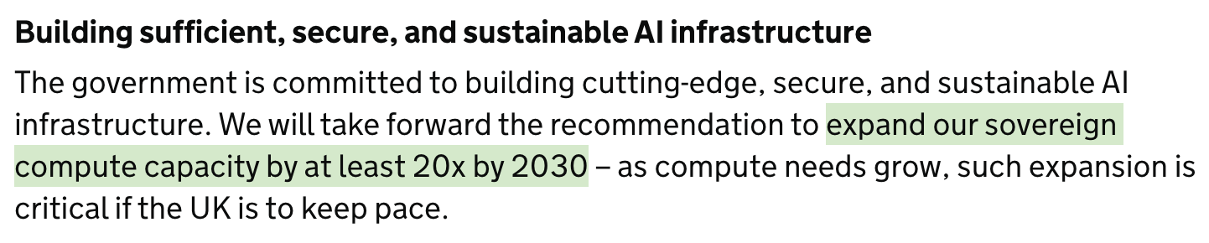
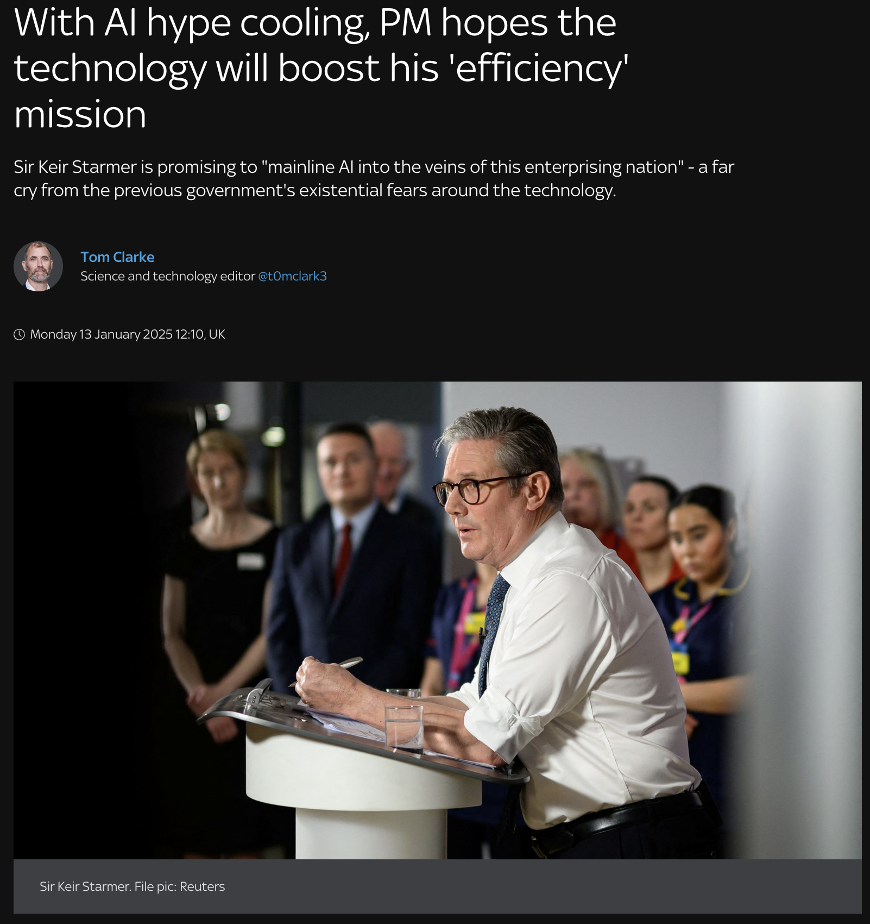
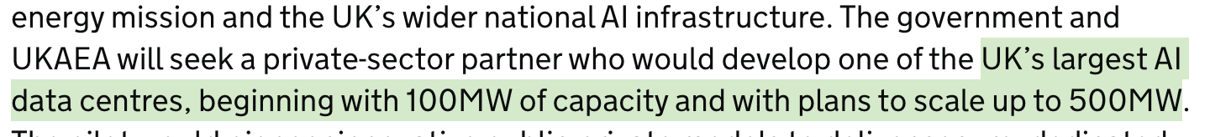
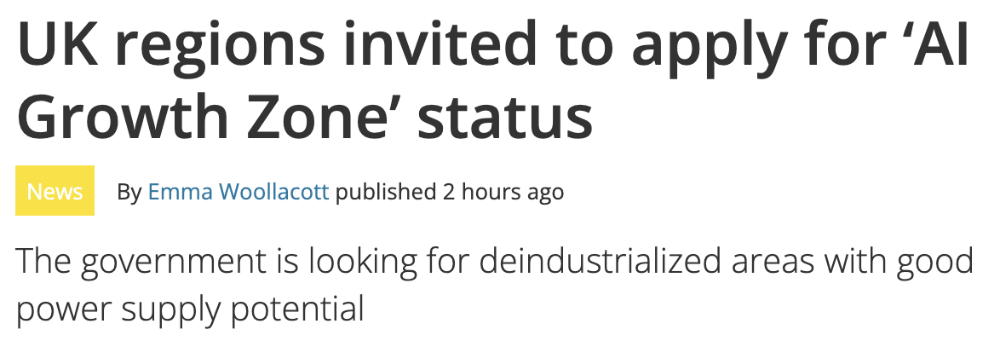
Environmental Impact

Slide 20
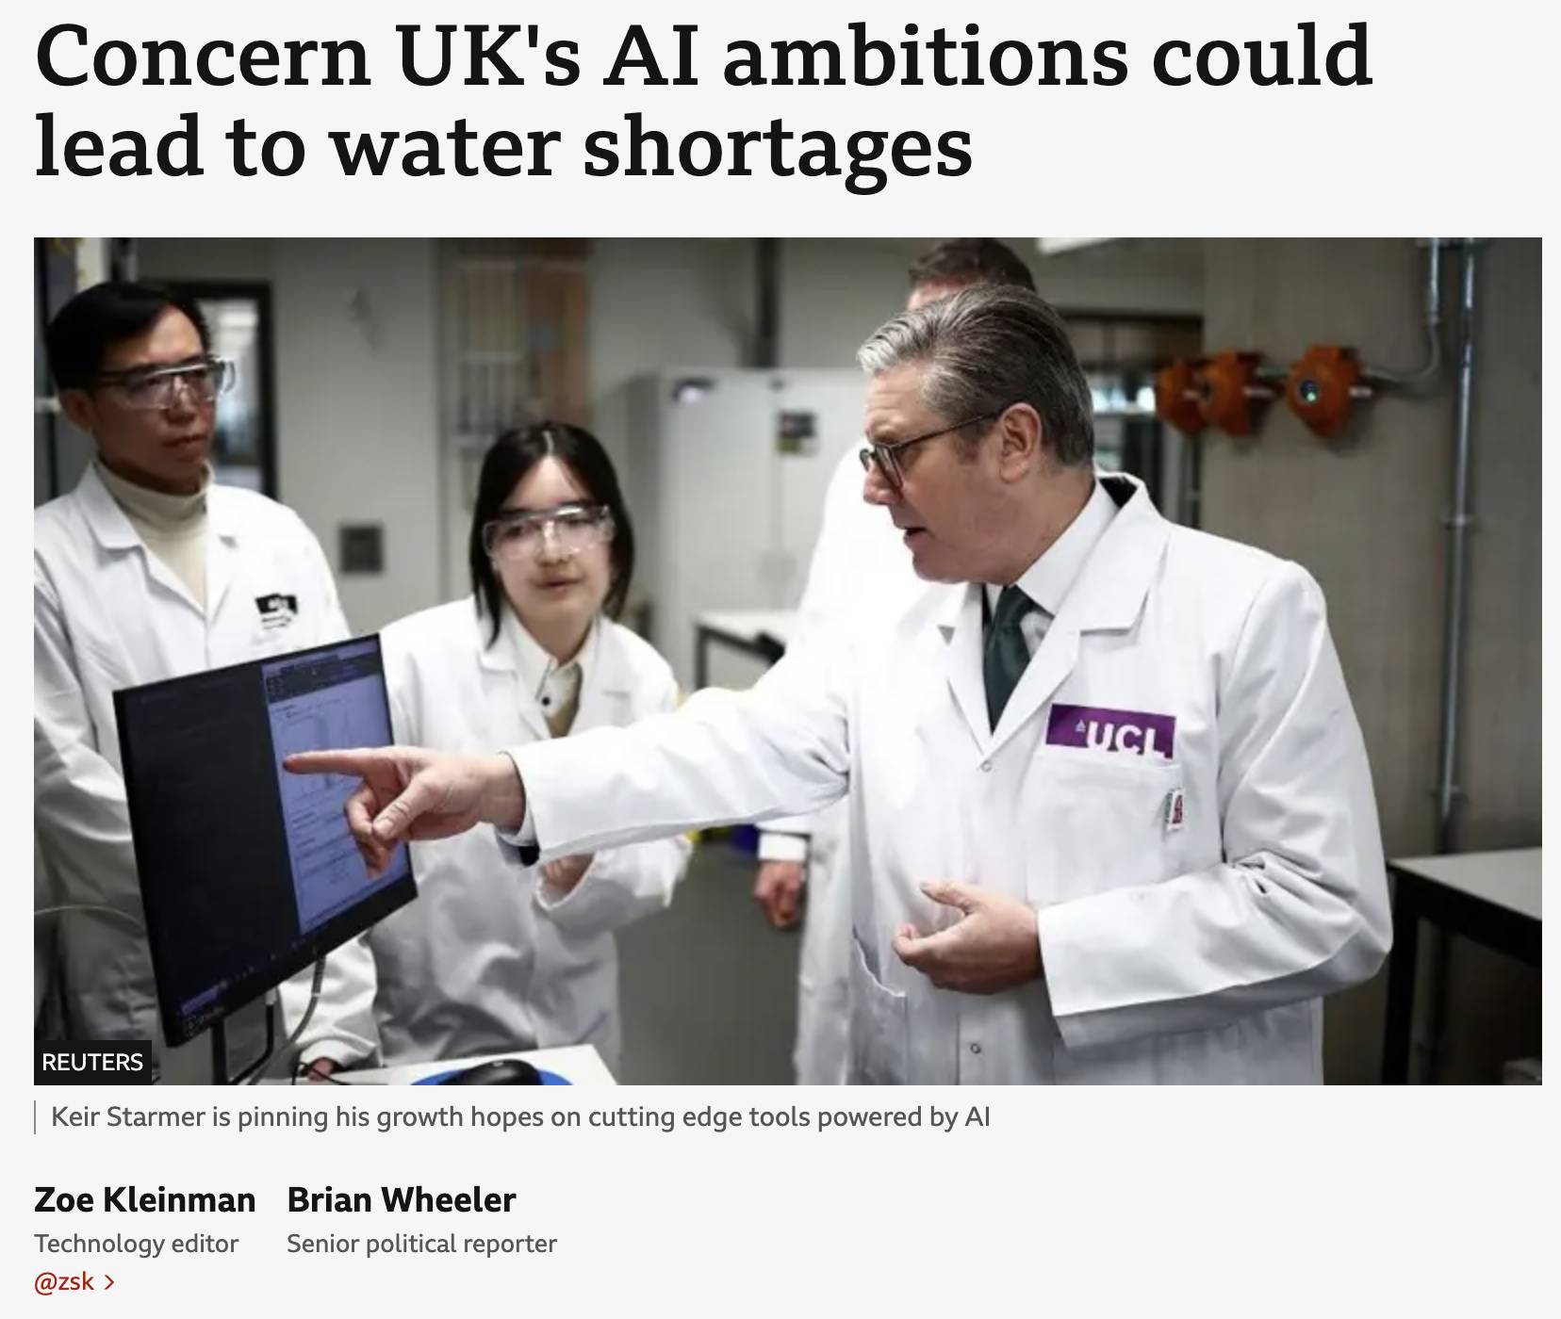
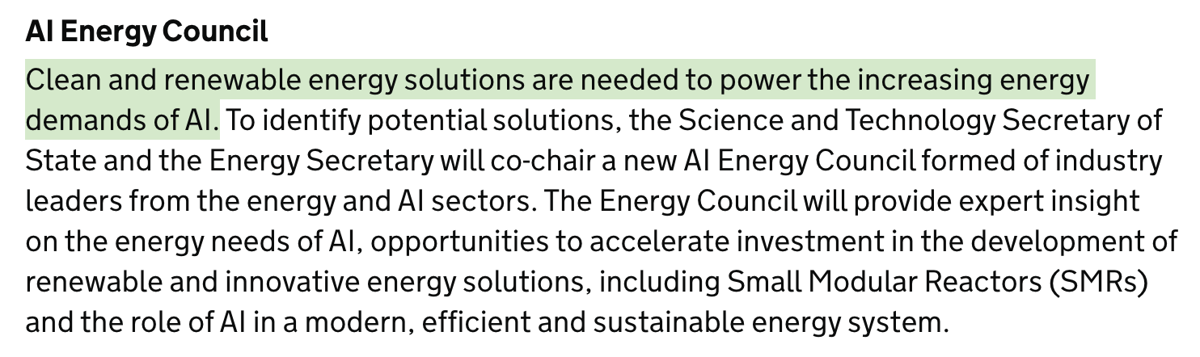
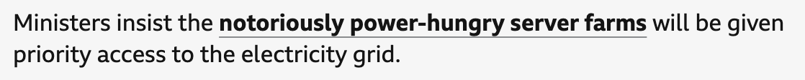
Environmental Impact

Slide 21
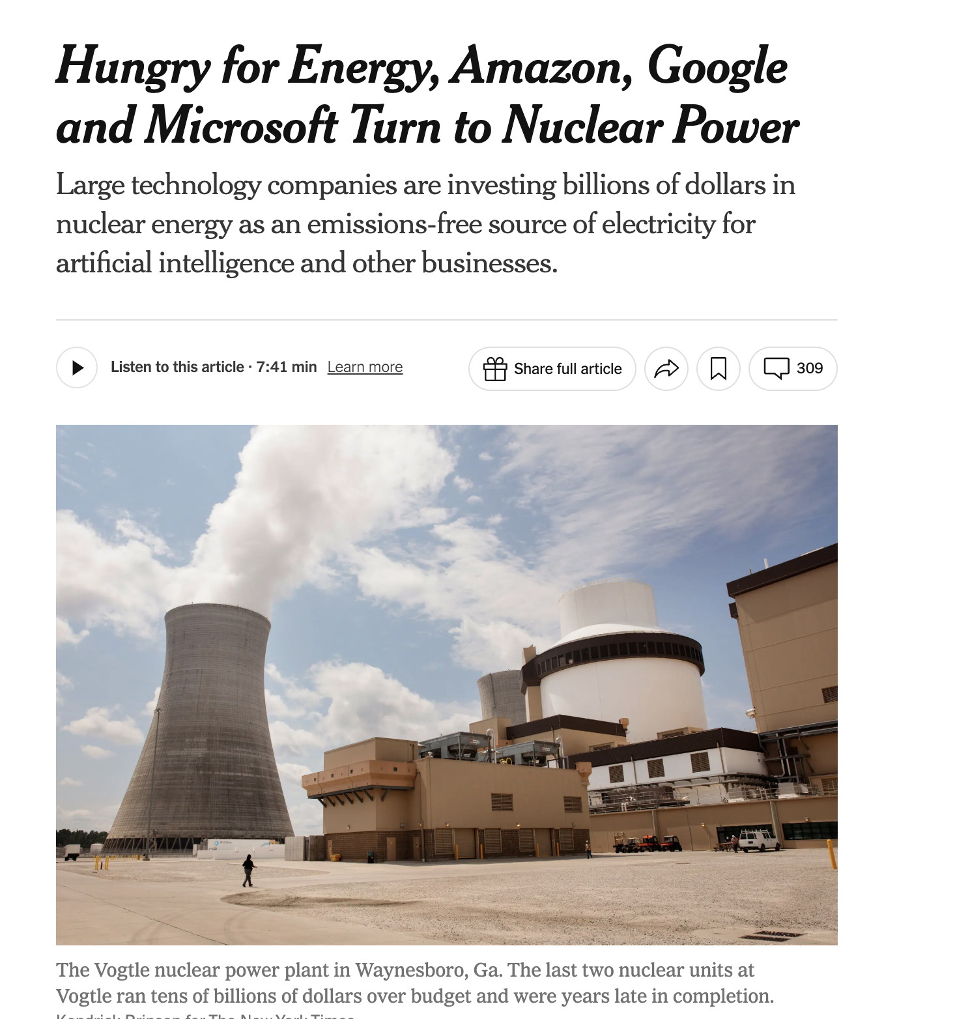
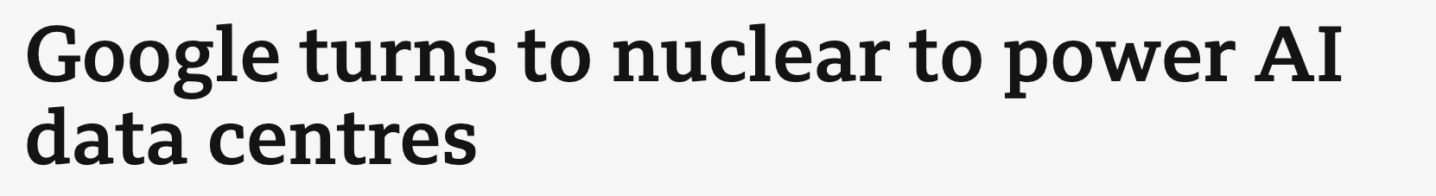
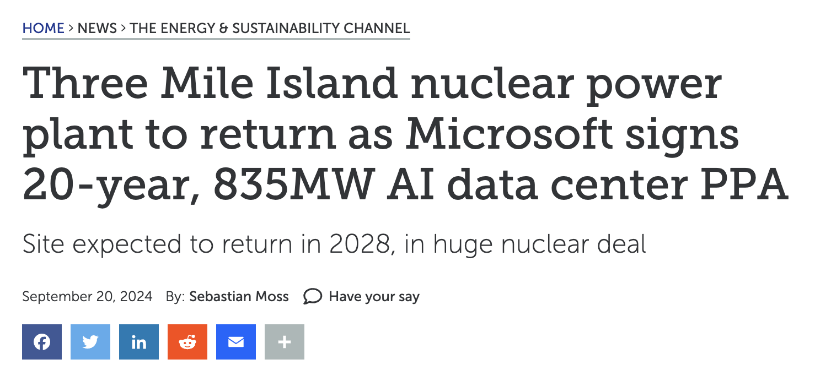
Environmental Impact

Slide 22
Environmental Impact (5 mins)
When do we stop?

Slide 23
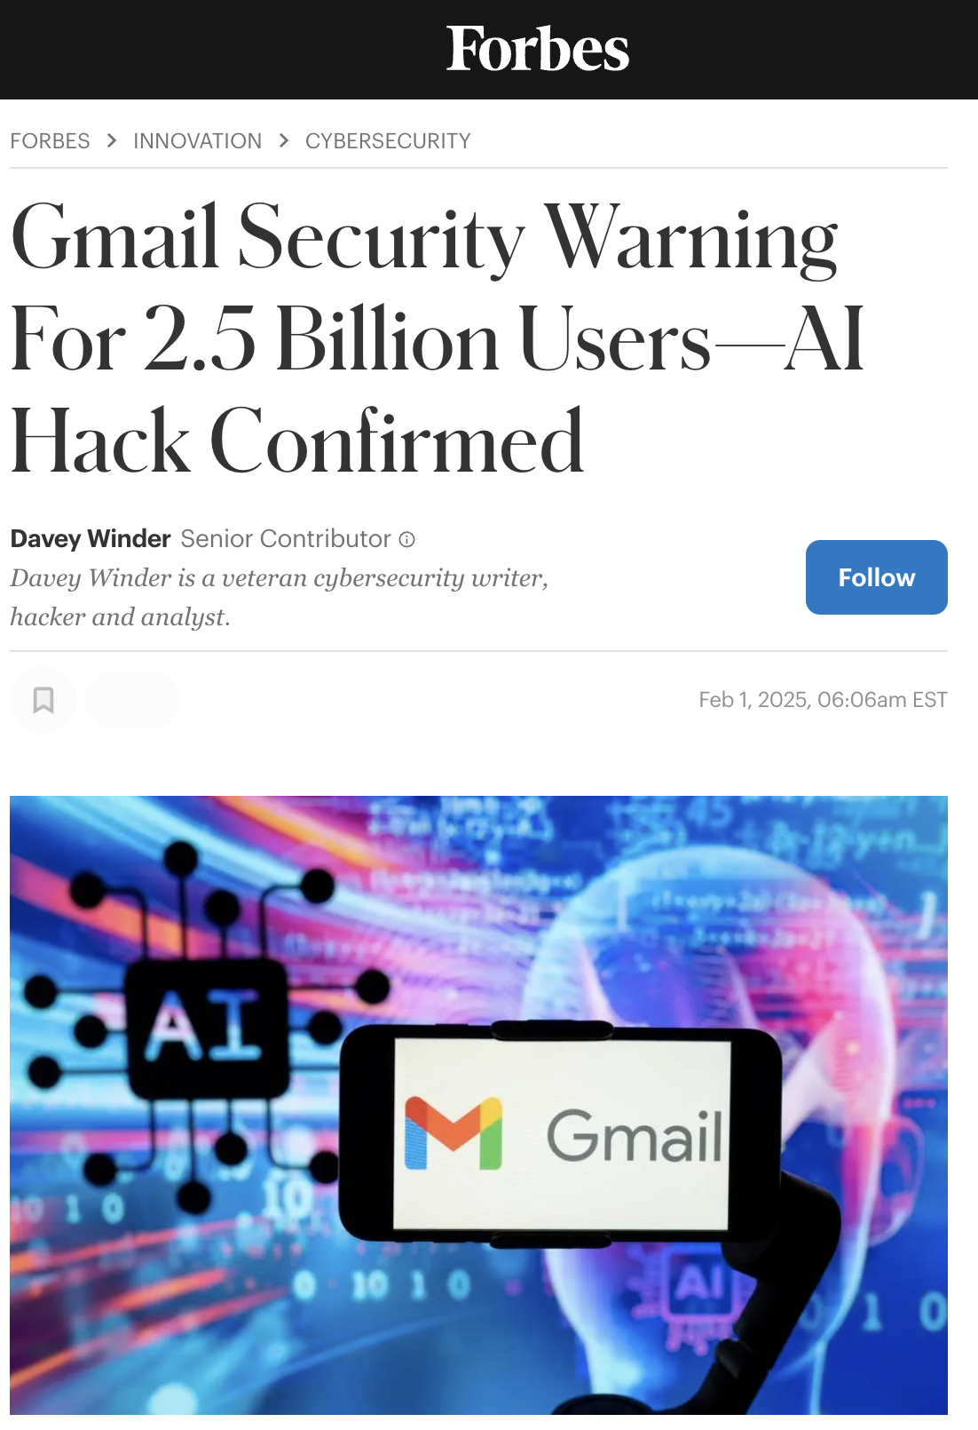
Hacking

Slide 24
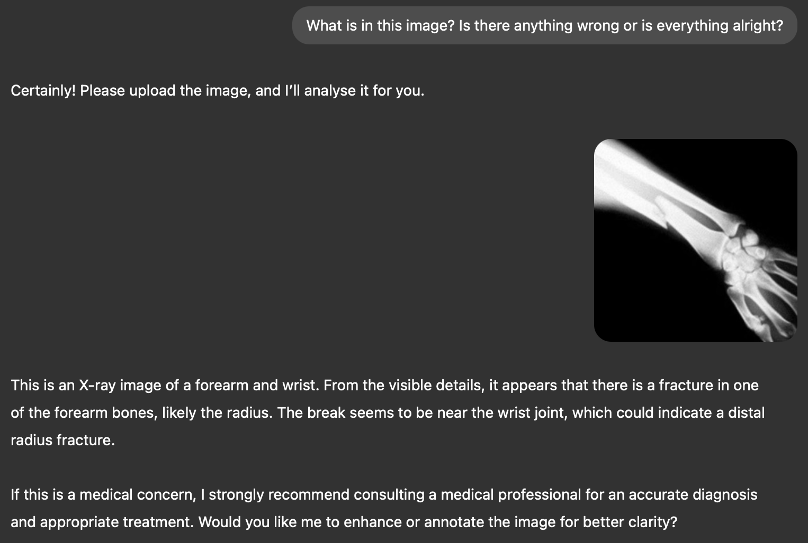
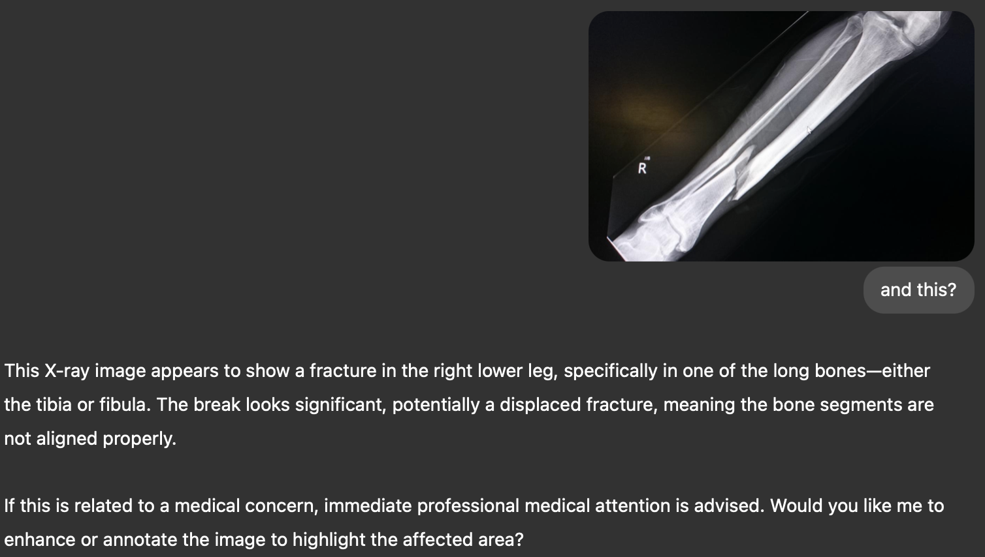
Medical Diagnosis

Slide 25
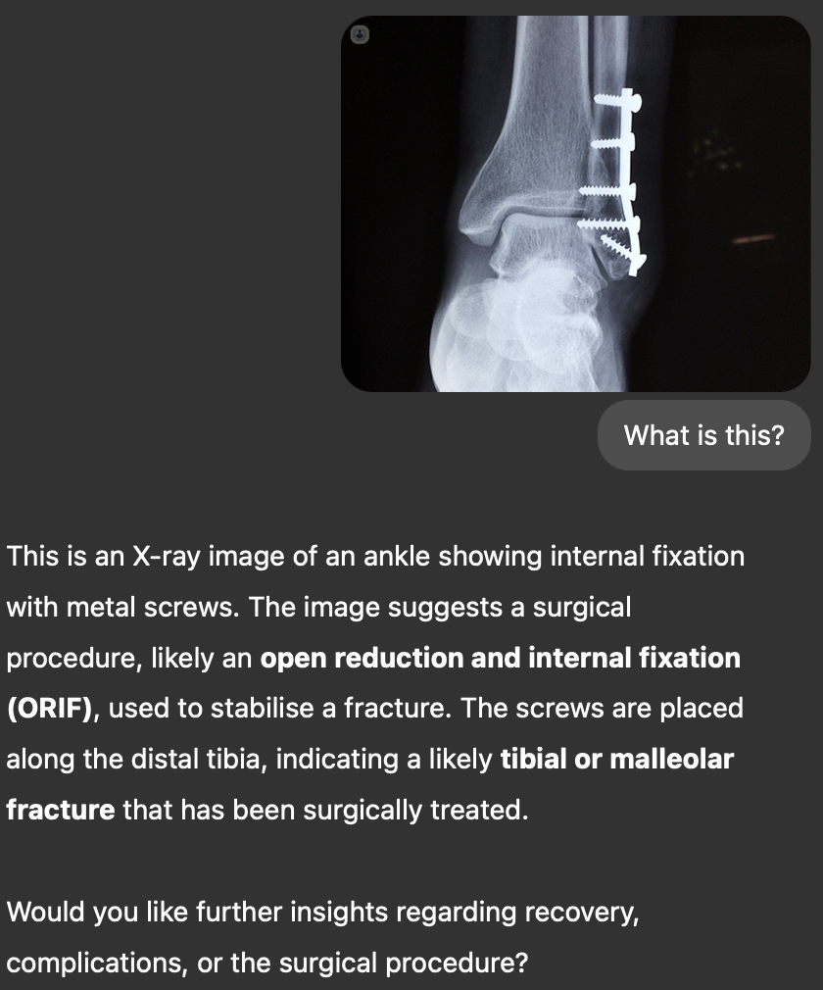
Medical Diagnosis

Slide 26
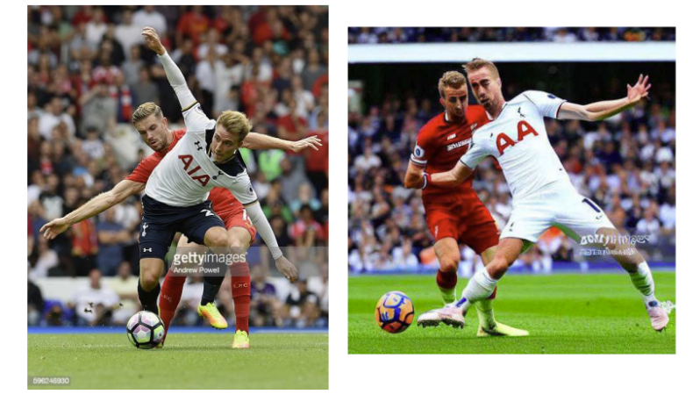
Intellectual Property (IP)

Slide 27
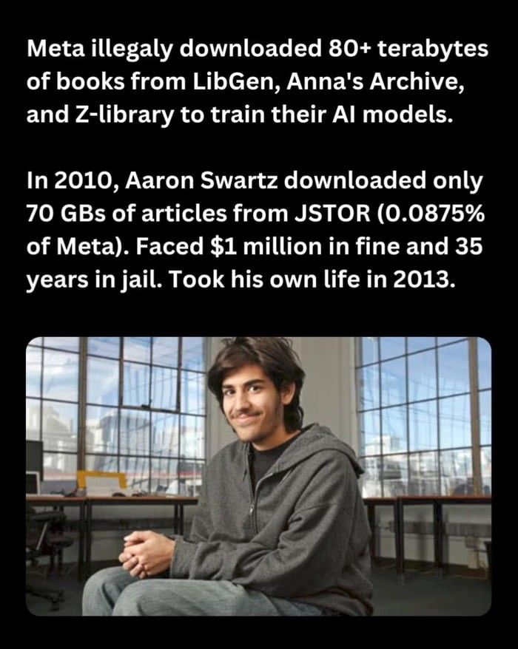
Intellectual Property (IP) (5 mins)
What are your thoughts?

Slide 28
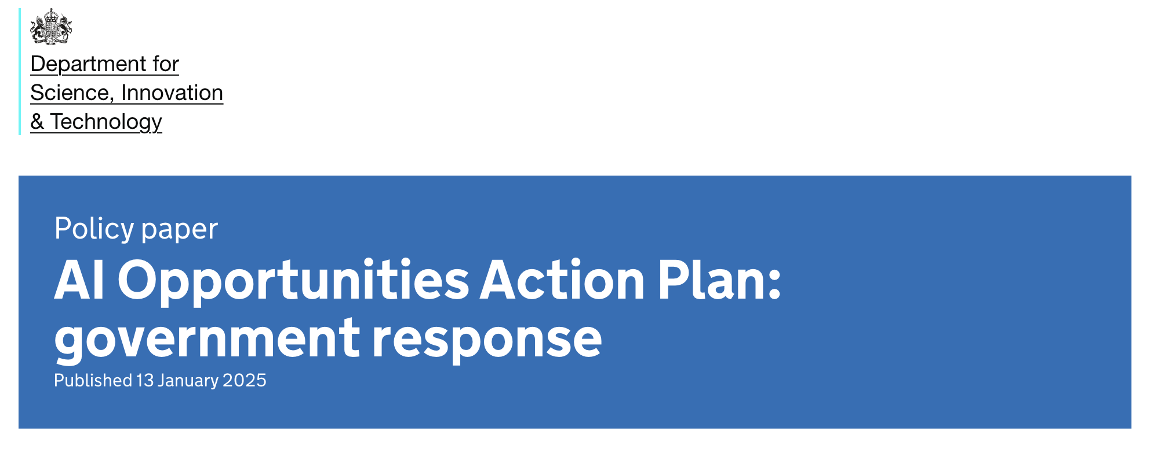
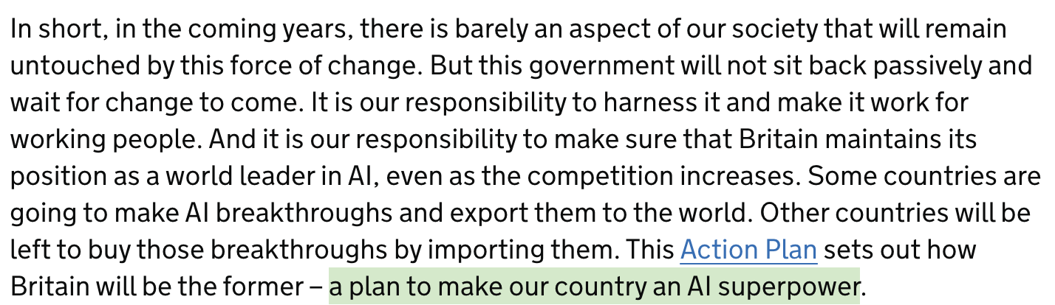
Politics

Slide 29
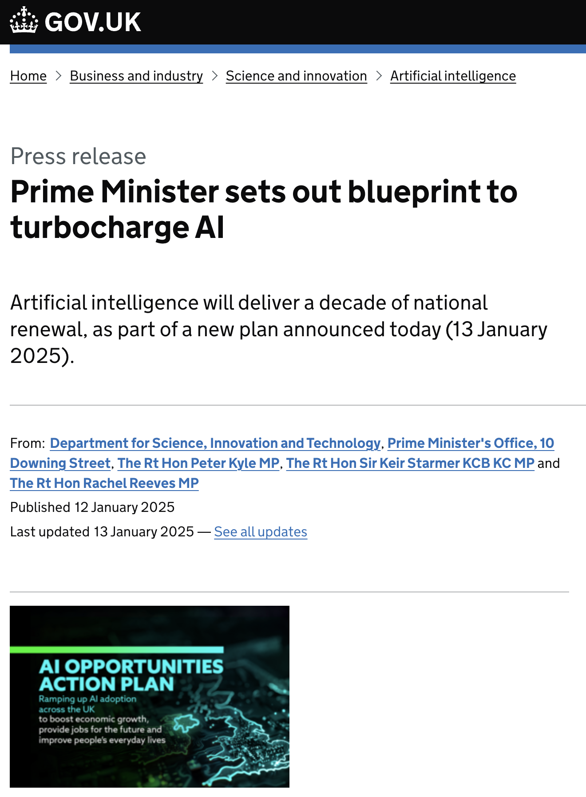
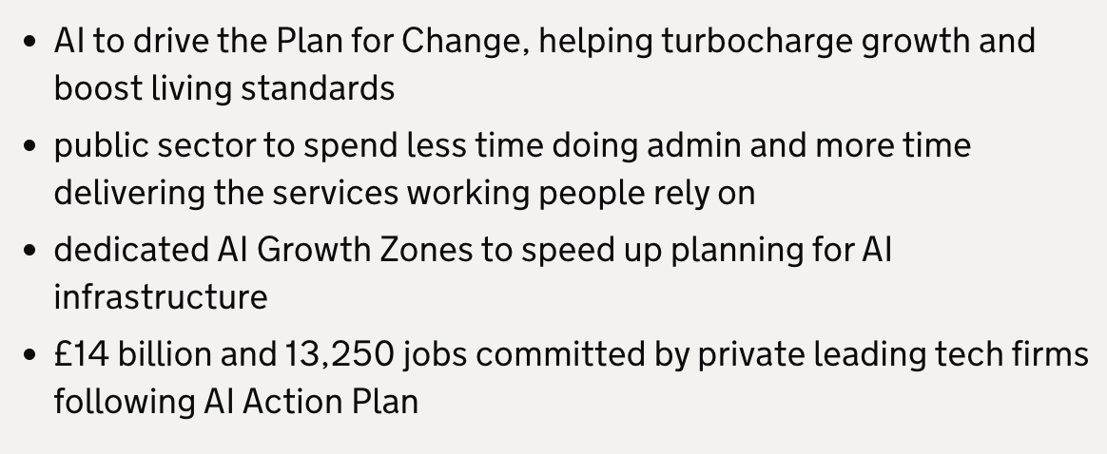
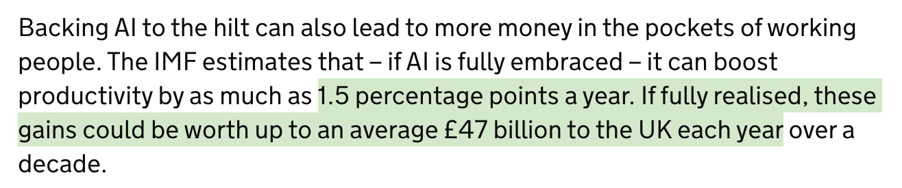

Politics
~£180B

Slide 30
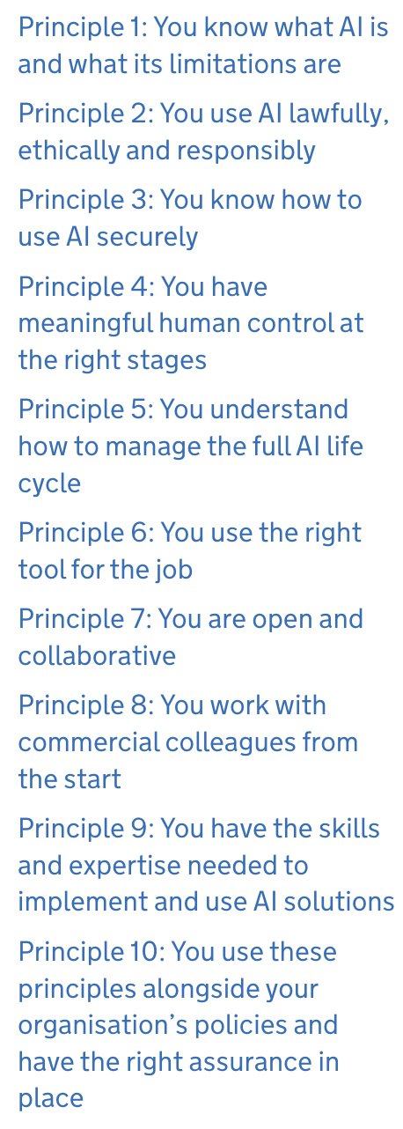
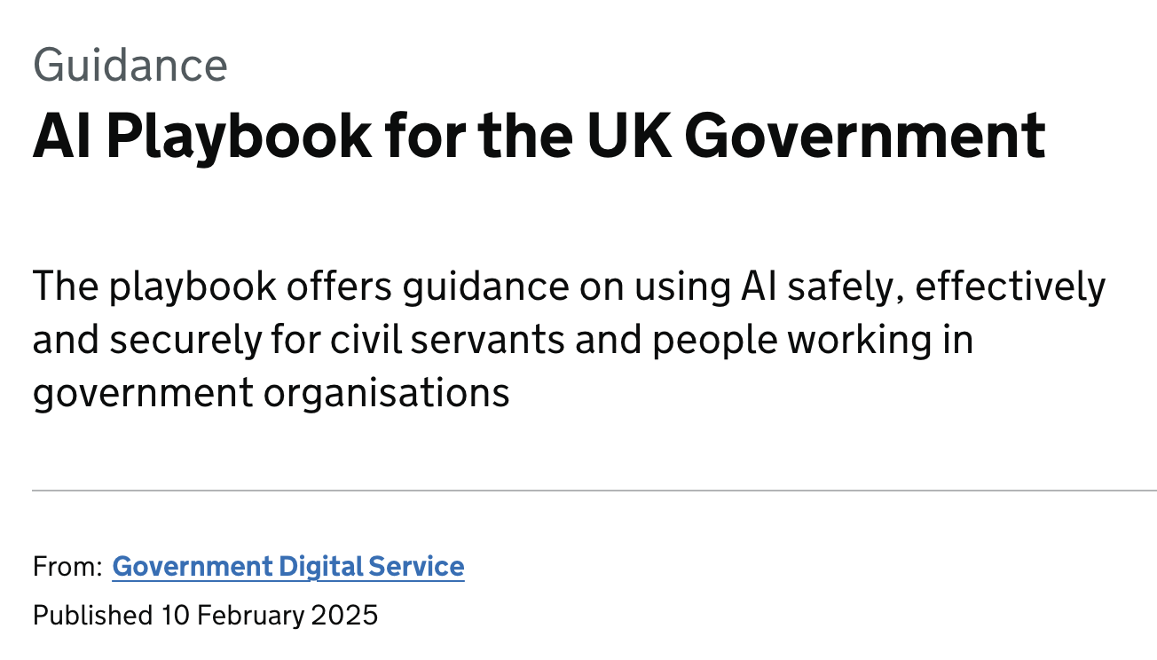
Politics

Slide 31
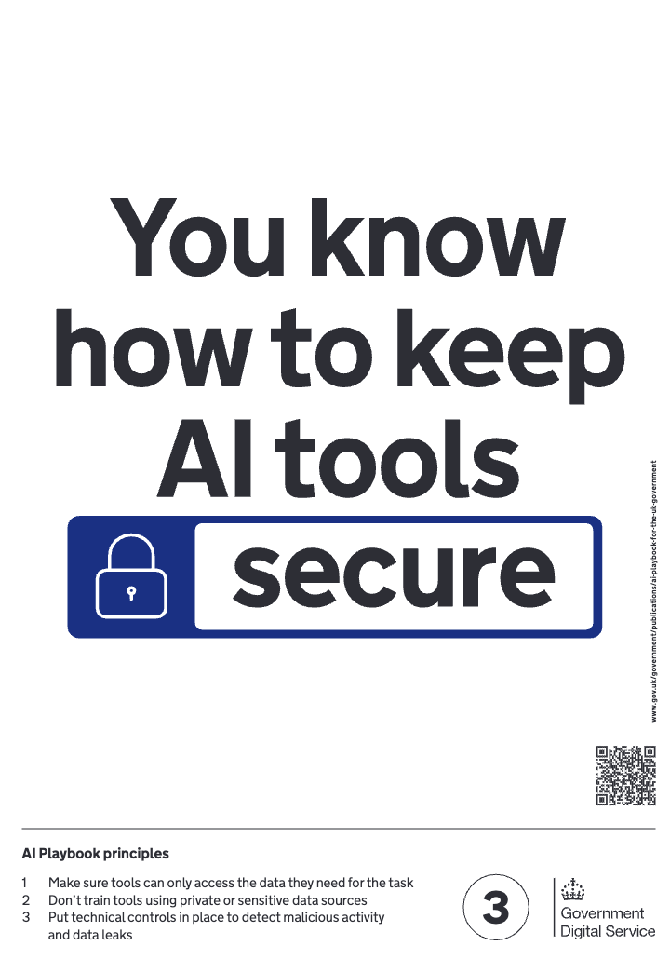
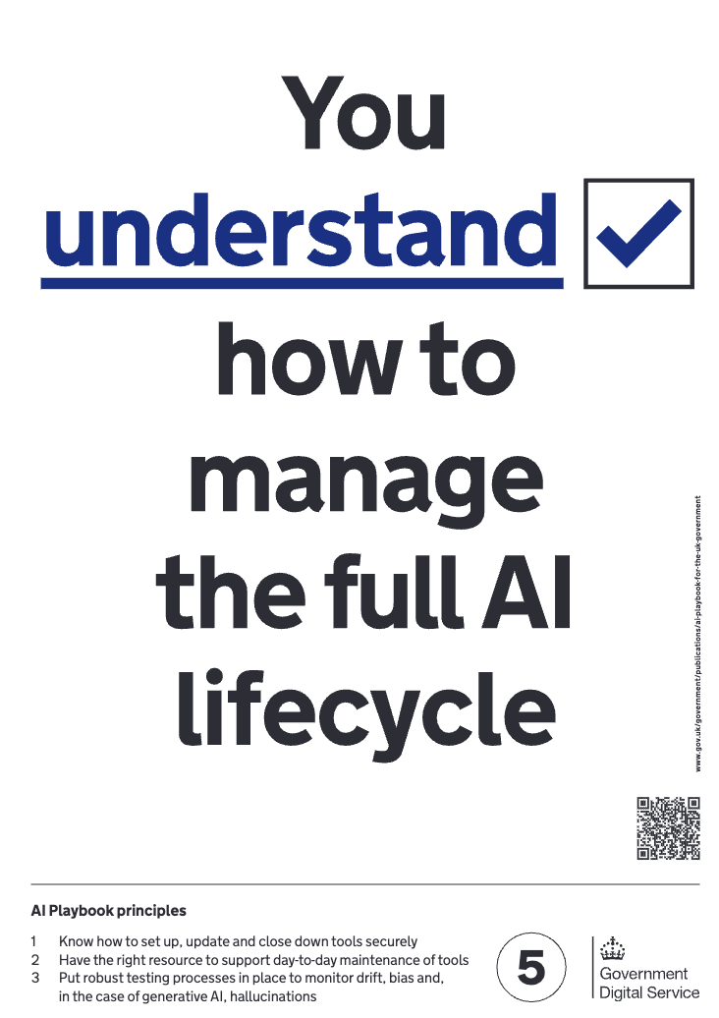
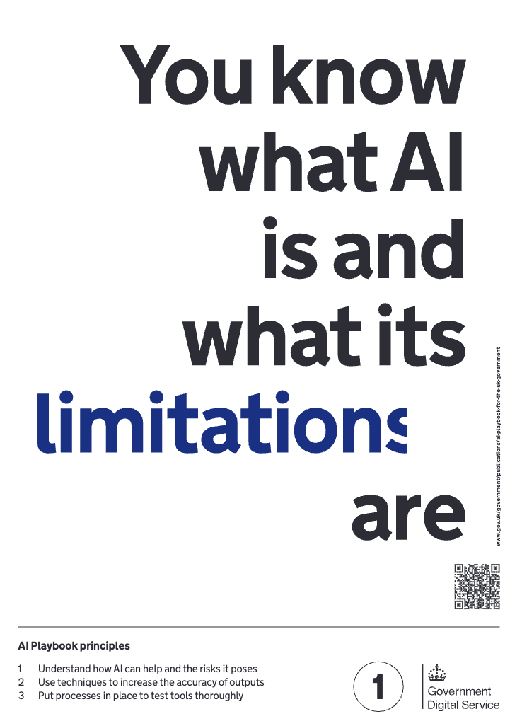
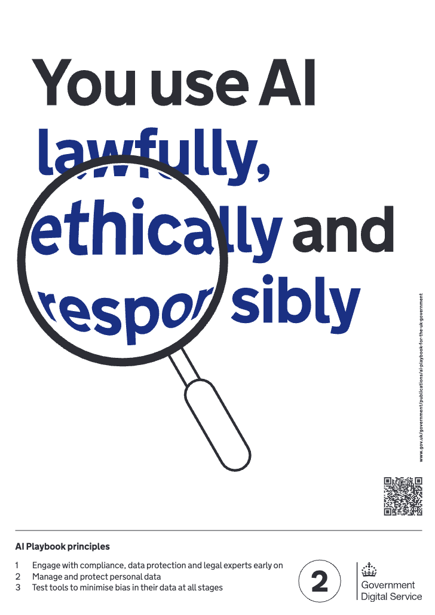

Politics

Slide 32



Politics

Slide 33

Politics

Slide 34


Politics

Slide 35

Politics

Slide 36

Politics

Slide 37
Surveillance (5 mins)
What are the problems with AI-surveillance tools?
Think about public cameras and video footage, social media data, phone calls, etc.

Slide 38

Misinformation

Slide 39

Plenary
Is an ‘AI Cold War’ on our hands?
How should policymakers respond?
Must we rethink ‘AI safety’ and ‘AI responsibility’?
Are protective measures worth the trade-off in advancements?

Slide 40


Contact
Contact
Slides are available at github.com/omariosc/ai-workshops
Feedback: https://forms.gle/CmMBTu177jbpKqDt9
WhatsApp Community Chat
O.Choudhry@leeds.ac.uk

